Slide 1
RESOURCE KIT
INSTALATION

Slide 2
AGENDA
Resource Kit Installation

Slide 3
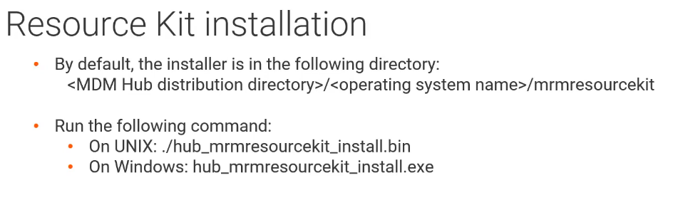
RESOURCE KIT

Slide 4
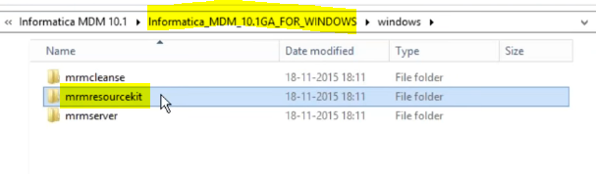
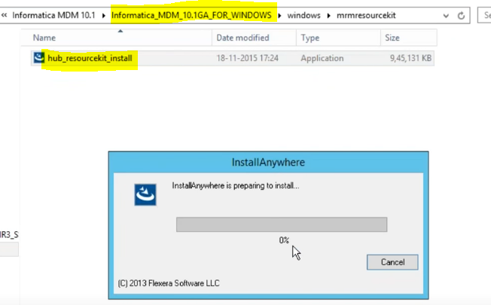
RESOURCE KIT
Once you download MDM software, Hub Server Installation file will be in “MRMSERVER” folder.
Inside “MRMSERVER” folder, you will get ‘hub_install’ executable file.

Slide 5
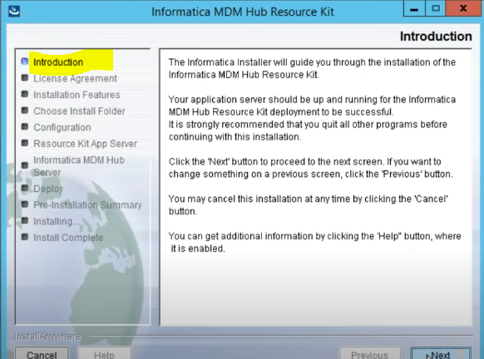
RESOURCE KIT
Installation starts.

Slide 6
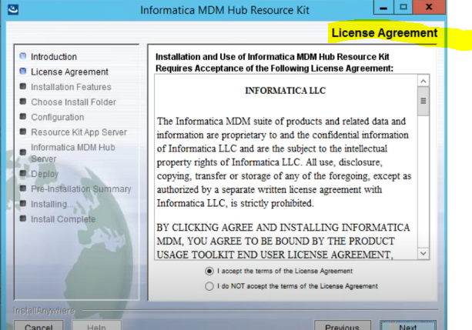
RESOURCE KIT
Accept the License and Agreement.

Slide 7
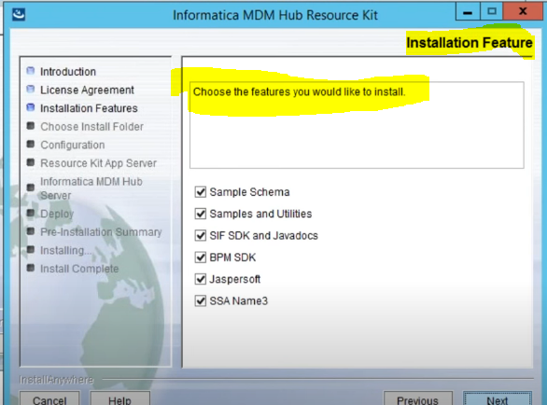
RESOURCE KIT
Select all Sample resource kit you want to install

Slide 8
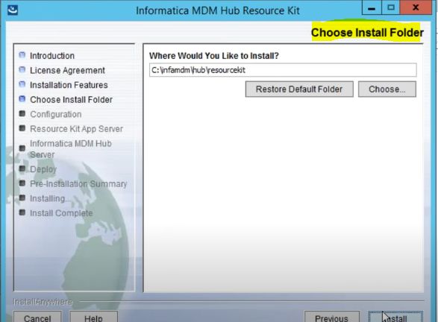
RESOURCE KIT
Select Install Folder.

Slide 9
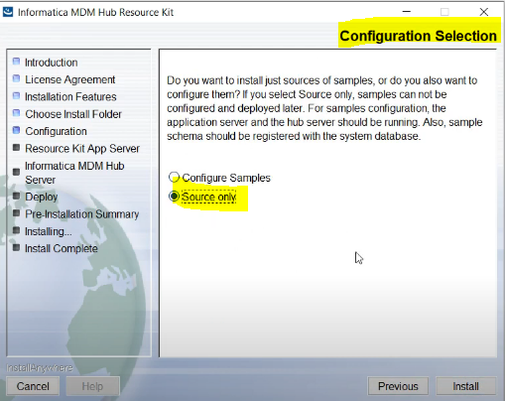
RESOURCE KIT
Select Source or Configuration Samples

Slide 10
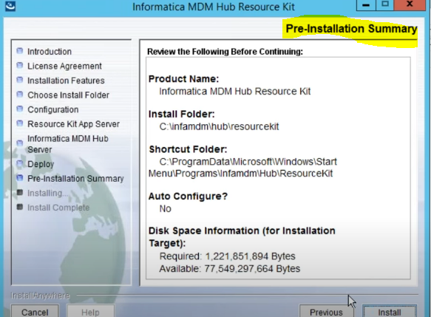
RESOURCE KIT
Pre-Installation Summary

Slide 11
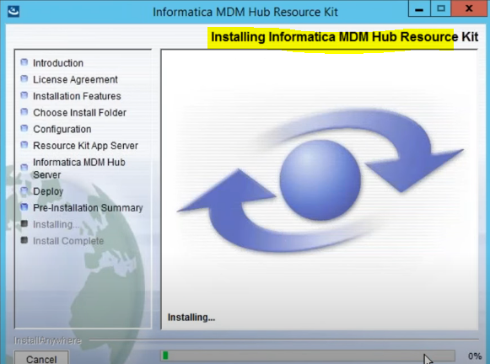
RESOURCE KIT
Installation Starts

Slide 12
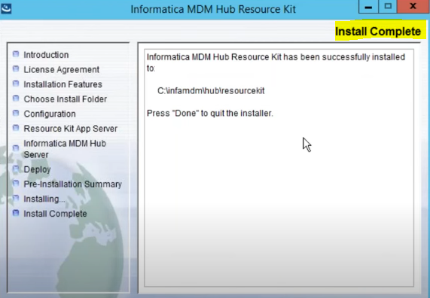
RESOURCE KIT
Installation Completed

